Slide 1
Capstone Project
Online Retail Customer Segmentation Unsupervised ML By Name: Md Sohail Tanveer

Slide 2
Business Context
In this project, your task is to identify major customer segments on a transnational data set that contains all the transactions occurring between 01/12/2010 and 09/12/2011 for a UK-based and registered non-store online retail. The company mainly sells unique all-occasion gifts. Many customers of the company are wholesalers.

Slide 3
Table of Content
Know Your Data
Understand Your Variable
EDA Exploratory Data Analysis
Feature Engineering
RFM Model Analysis
ML Model Implementation
Conclusion

Slide 4
1. Know Your Data
In this section we will perform a series of operations:
Import important python libraries
Load the dataset
Get a preview of the dataset
Count the number of rows and columns in the dataset
Count the duplicated values in the dataset
Find the total missing or NULL value in the dataset
Handle those missing or NULL values

Slide 5
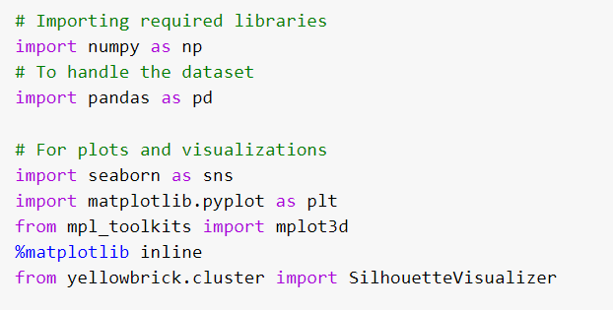
Importing Libraires
Libraries have important predefined functions and methods which help in complex programming or analysis. Here we have imported.

Slide 6
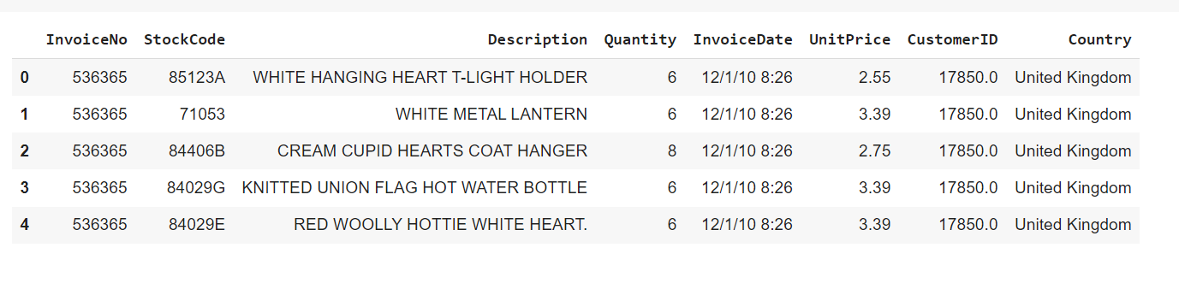
Loading Dataset
After loading the dataset, we have a preview like this.
We have total of 5,41,909 observations and 8 features.

Slide 7
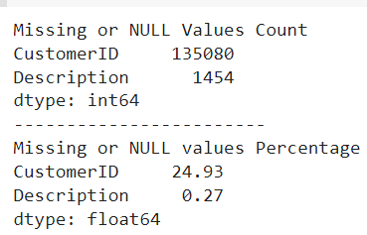
Dataset Information
Dataset has 268 duplicated observations
Description column has 1454 null values and CustomerID has 135080 null values.
24.93% of items purchases are not assigned to any customer
Hence there is no use in having the data with no customer assignment. Because we can’t form clusters without CustomerID so we will delete them from the dataset.

Slide 8
2. Understand Your Variable
The list of data columns are ['InvoiceNo', 'StockCode', 'Description', 'Quantity', 'InvoiceDate', 'UnitPrice', 'CustomerID', 'Country’].
We have three numerical features ‘Quantity’, ‘CustomerID’, and ‘UnitPrice’.
We have one DateTime variable 'InvoiceDate’.
We have categorical variables 'Description', 'Country’, and 'StockCode’.

Slide 9
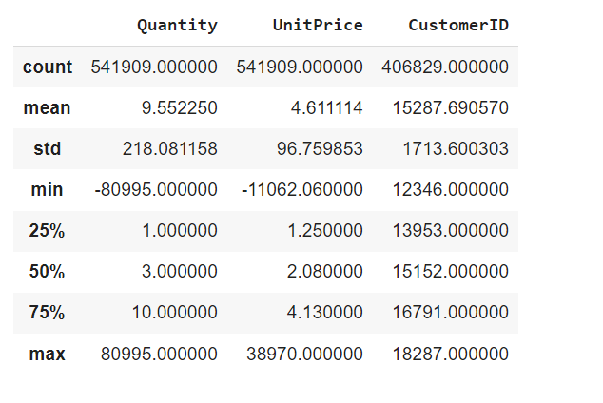
Data describe
UnitPrice has a minimum value negative which is not possible. So we will replace the negative value with the median value.

Slide 10
Variables Description
Invoice No: Invoice number. Nominal, is a 6-digit integral number uniquely assigned to each transaction. If this code starts with the letter ‘C', it indicates a cancellation.
StockCode: Product (item) code. Nominal, is a 5-digit integral number uniquely assigned to each distinct product.
Description: Product (item) name. Nominal.
Quantity: The quantities of each product (item) per transaction. Numeric.
InvoiceDate: Invoice Date and time. Numeric, the day and time when each transaction was generated.
UnitPrice: Unit price. Numeric, Product price per unit in sterling.
CustomerID: Customer number. Nominal, is a 5-digit integral number uniquely assigned to each customer.
Country: Country name. Nominal, is the name of the country where each customer resides.

Slide 11
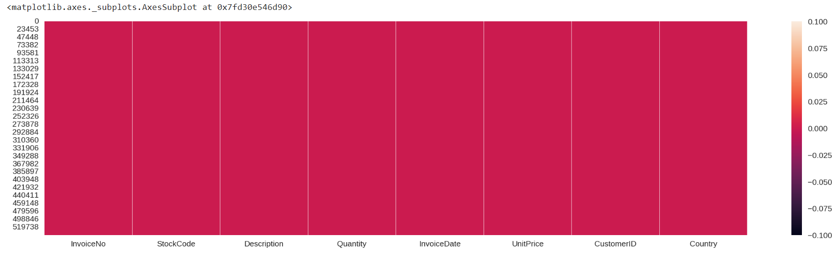
Data Cleaning
Dropping all observations with NULL values.
Now the dataset has only 4,01,565 observations and 8 columns
We can see that from the heatmap, The dataset is cleaned and ready for EDA.

Slide 12
3. EDA Exploratory Data Analysis
An EDA is a thorough examination meant to uncover the underlying structure of a data set and is important for a company because it exposes trends, patterns, and relationships that are not readily apparent.
Pre-processing:
We have extracted hour, day, month, and year from the InvoiceDate column.
Create a new feature 'TotalAmount' by multiplying Quantity and UnitPrice.
Creating a new feature 'TimeType' based on hours to define whether it’s Morning, Afternoon, or Evening.
Extract the canceled order Invoice from the dataset which starts with 'C’ in InvoiceNo.

Slide 13
We have a total of 8872 cancelation requests.
We will drop the cancellation invoice from the main dataset So that it will affect the insights.
Now we will do EDA using five different parameters:
Country
Quantity
Product
Time
Amount
Cancellation

Slide 14
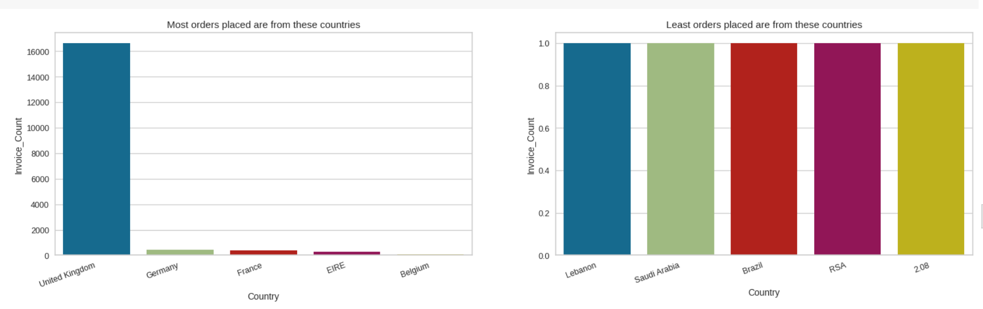
Country
We have a total of 38 unique values for Country.
Most of the orders are from the United Kingdom, Germany, France, EIRE, and Belgium While the least orders are from Lebanon, Saudi Arabia, Brazil, and RSA.

Slide 15
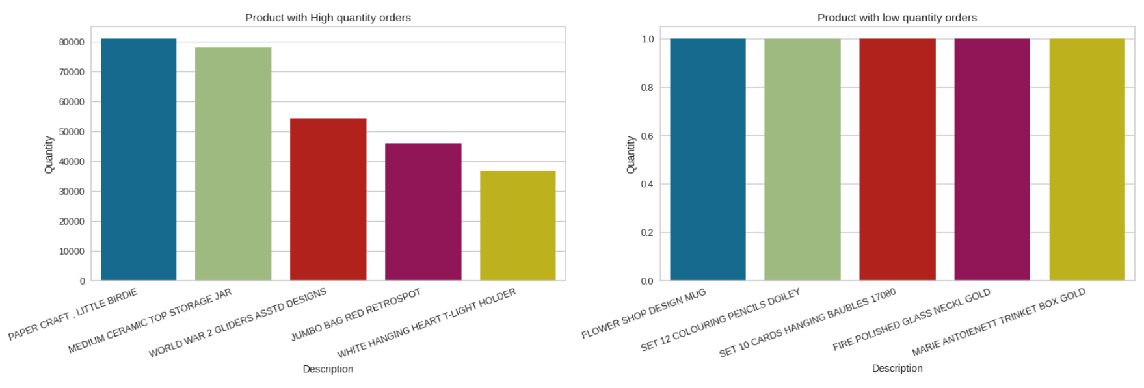
Quantity
Product with the highest order quantity is Paper Craft, Little Birdie. While the least ordered product is Marie Antoinette Trinket Box Gold.

Slide 16
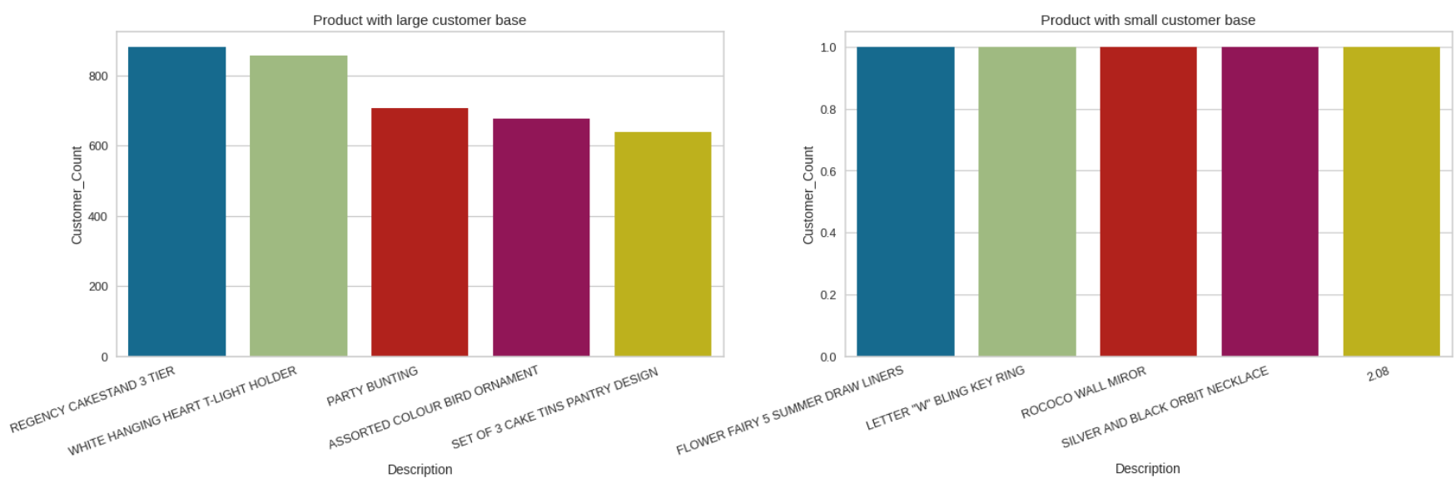
Product
Regency cake stand 3 tier has been bought by most of the customers and the Silver and Black Orbit Necklace has been bought only once.

Slide 17
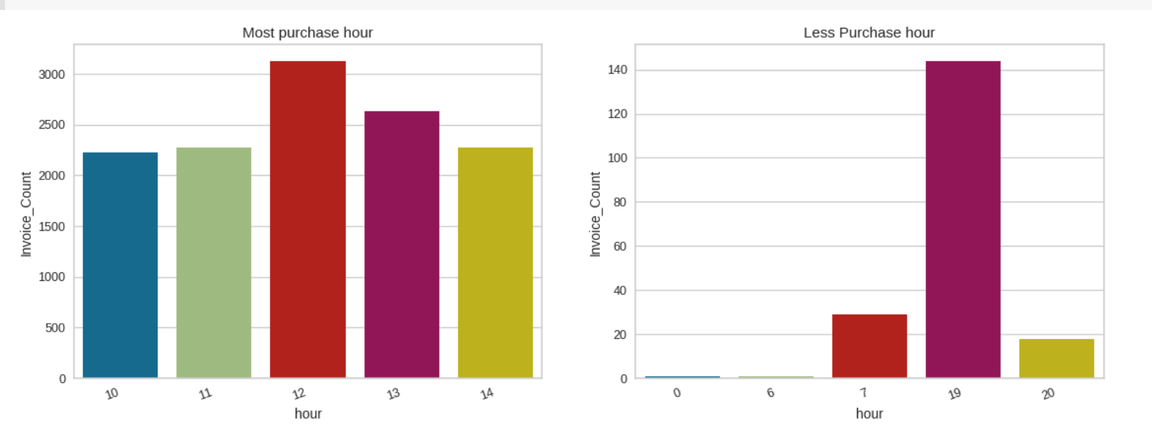
Time
Most of the purchases are made in the month of November and the Least purchase has been made in January.
Most of the purchases are made on Thursday while there is no purchase made on Saturday, I guess it Non-functioning day.
Most of the purchases are made in the afternoon while almost negligible purchases are made at the night.

Slide 18
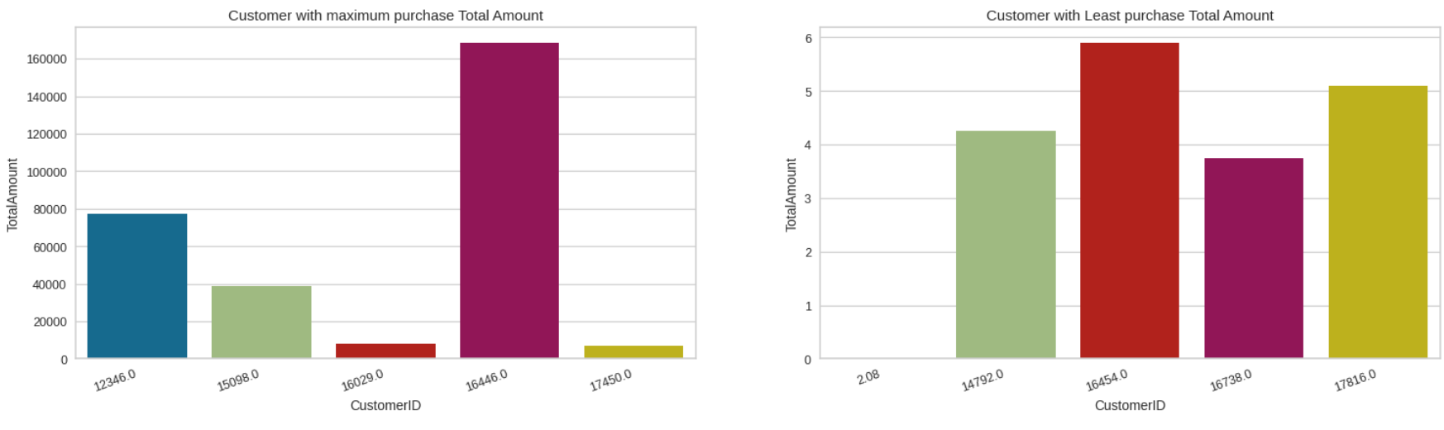
Total Amount
Highest purchase total amount of $ 1,68,469 made by a Customer with CustomerID 16446.
Least purchase total amount is $ 3.75 by Customer with CustomerID 16738.

Slide 19
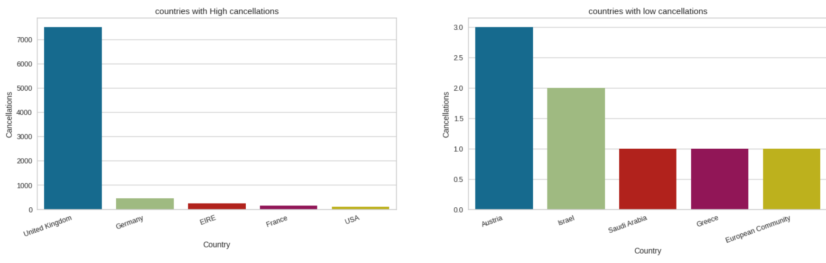
Cancellation
Since most of the orders are from the UK then it’s obvious that it will be having most cancellation requests.
The country with the least order cancellations are Saudi Arabia, Greece and European Community.

Slide 20
4. Feature Engineering
Feature engineering is the pre-processing step of machine learning, which is used to transform raw data into features that can be used for creating a predictive model using Machine learning or statistical Modelling.
Here we will transform months and days into numerical features.
In next we will do an analysis using RFM (Recency, Frequency, and Monetary) model to analyse a customer’s behaviour.
We will classify different customers on basis of their RFM score.

Slide 21
5. RFM Model Analysis
Recency: How recently did the customer visit our website or how recently did a customer purchase?
Frequency: How often do they visit or how often do they purchase?
Monetary: How much revenue do we get from their visit or how much do they spend when they purchase?
The RFM Analysis will help businesses segment their customer base into different homogenous groups to engage with each group with different targeted marketing strategies.

Slide 22
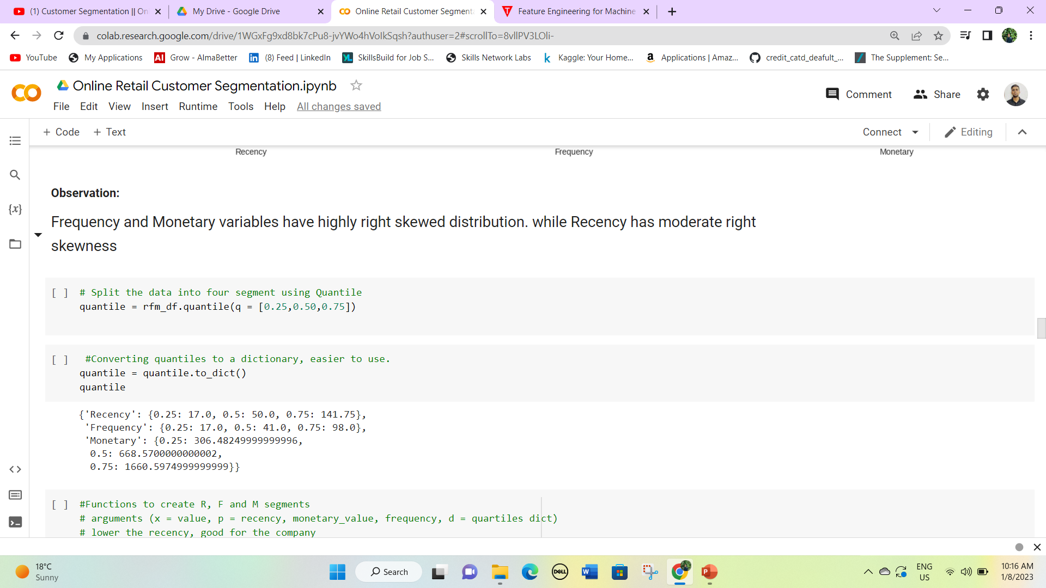
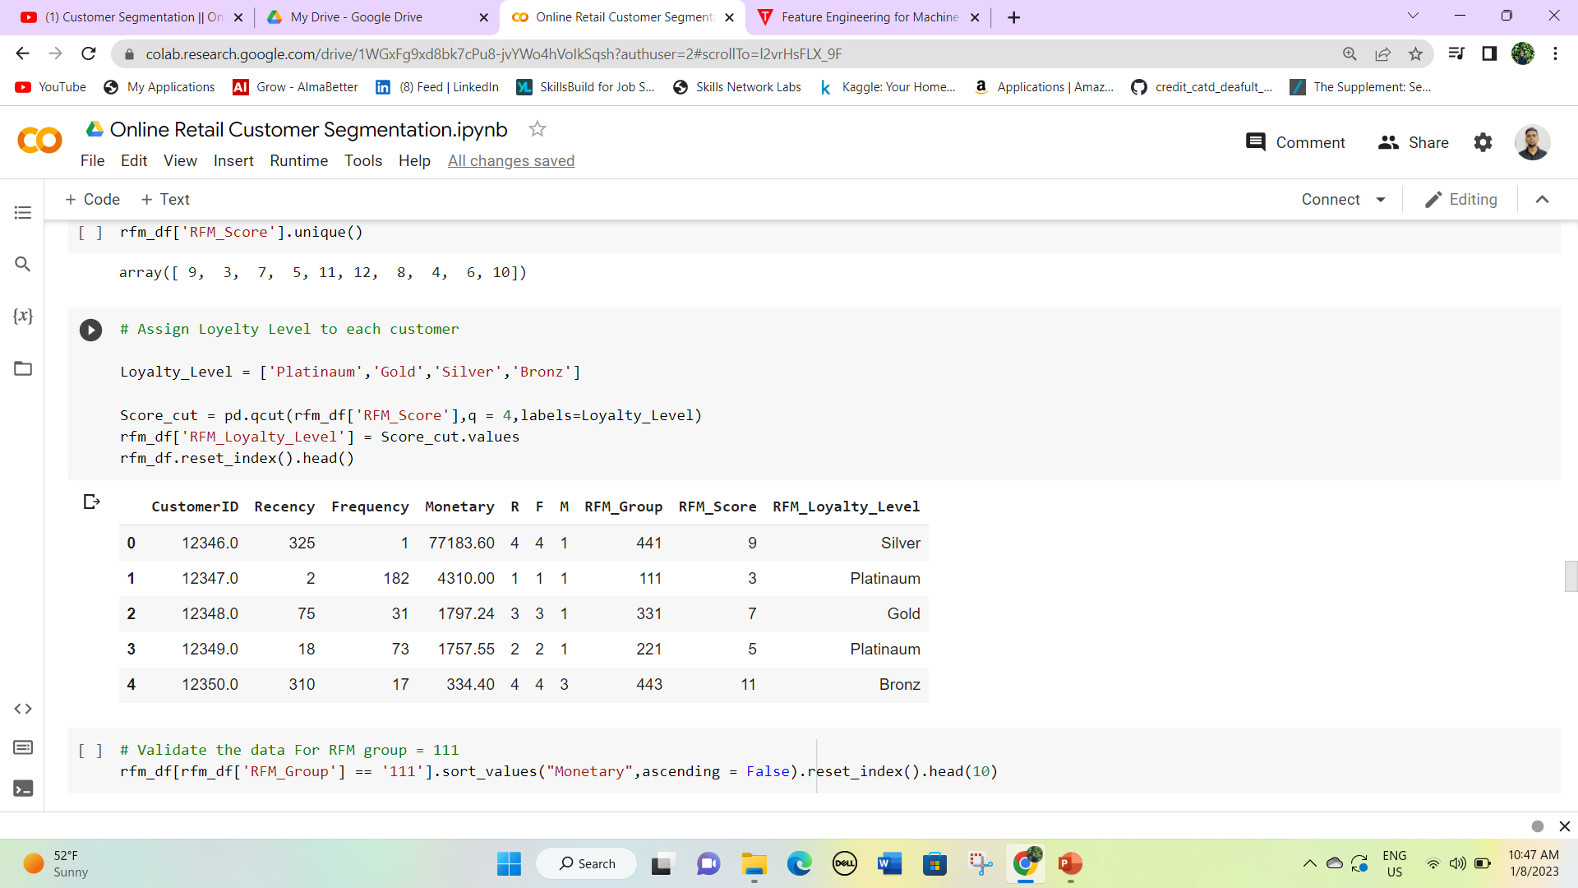
Recency=InvoiceDate – Last Invoice date
Frequency = Count of total invoices each customer
Monetary = Sum of the total amount of each Customer
R, F, and M numbers will be given using the quantile method
The customer will be divided on basis of loyalty level namely Platinum, Gold, Silver, and Bronz. Let’s see the count of customers in each category.

Slide 23
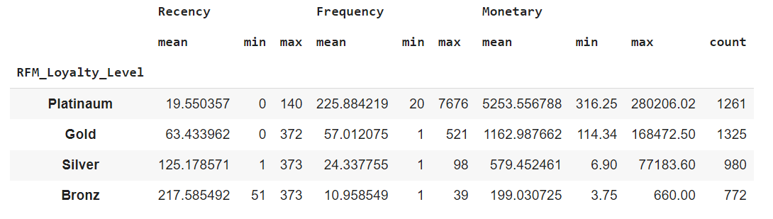
Platinum Customer Count is 1261.
Gold Customer Count is 1325.
Silver Customer Count is 980.
Bronz Customer count is 772.
Average purchase made by Platinum customers is 5253.55 which is huge.
Gold customers have a monetary of almost one-fifth of Platinum.
Silver and Bronz customers shops on a need basis.

Slide 24
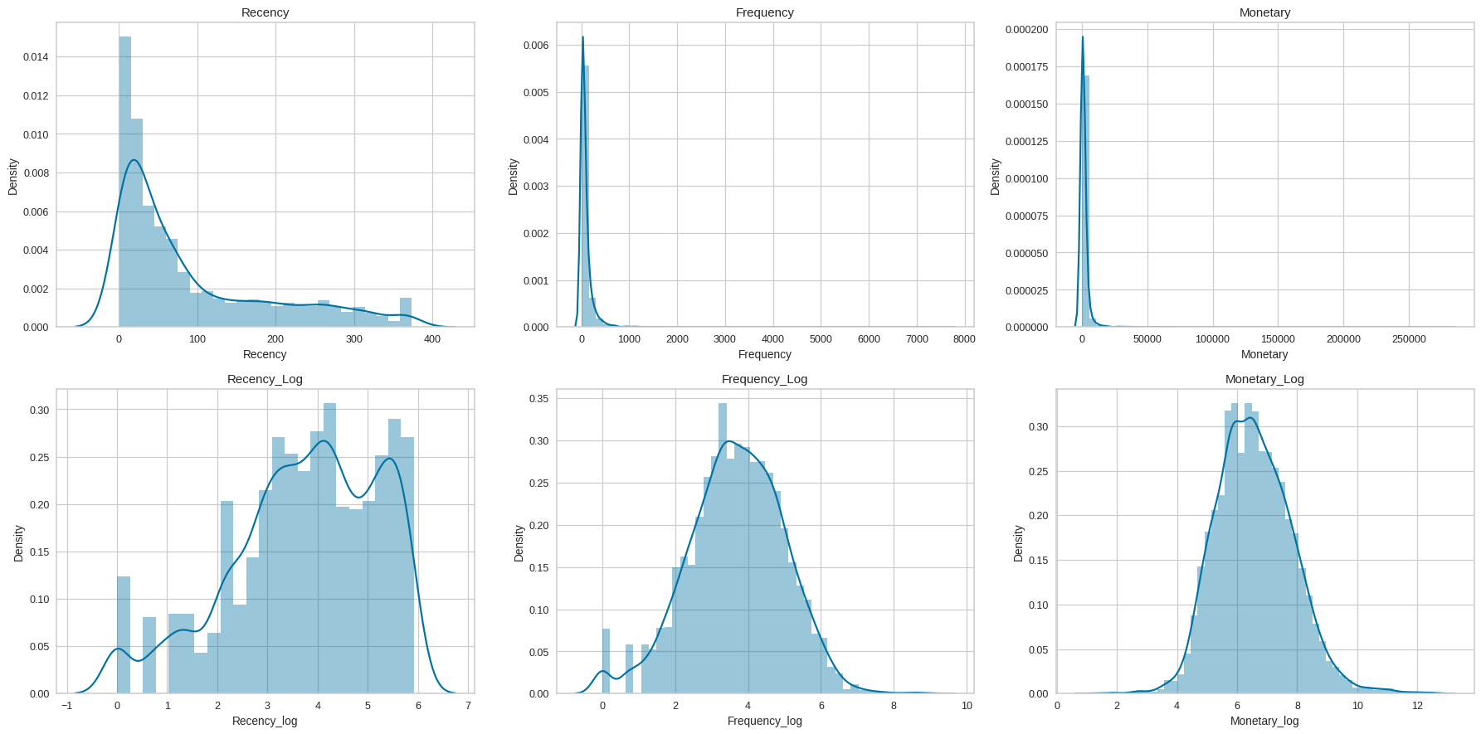
The distribution of the RFM features is highly right-skewed, So we will remove this skewness using log transformation.
The log transformation of RFM is normally distributed now it’s ready for model implementation.

Slide 25
6. ML Model Implementation
After all the hustle and hard work, Now our dataset is ready for model implementation
We will be implementing three clustering models with different parameters.
K-Means Cluster
Hierarchical Cluster
DB Scan Cluster

Slide 26
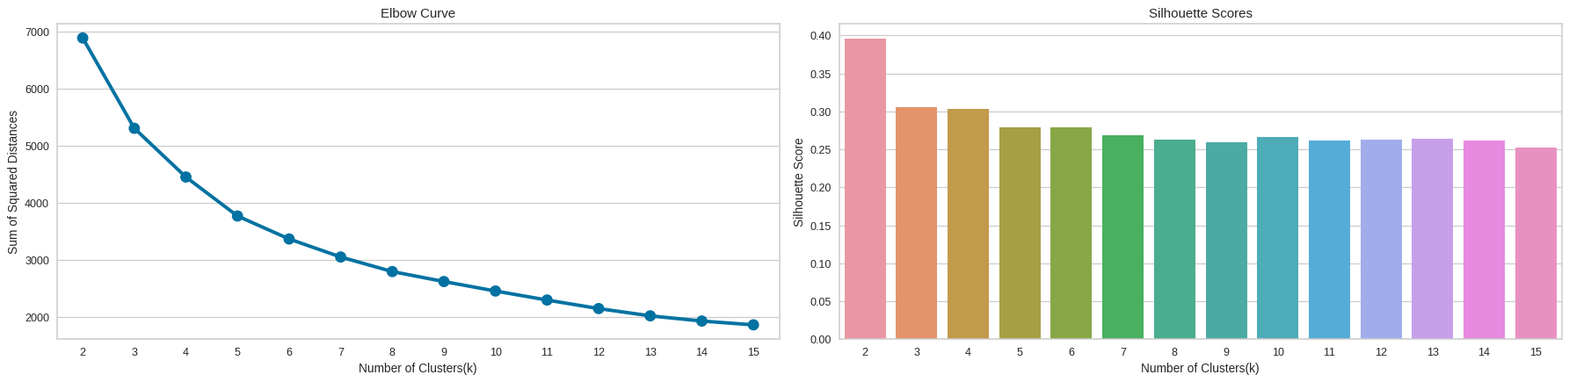
K-Means Clustering
From the Elbow curve 5 appears to be at the elbow and hence can be considered as the number of clusters. n_clusters=4 or 6 can also be considered based on the objective of segmentation.
If we go by maximum Silhouette Score as the criteria for selecting an optimal number of clusters, then n_clusters=2 can be chosen.
If we look at both of the graphs at the same time to decide the optimal number of clusters, we can take the intersection of the set of good n_clusters obtained from both graphs.
So 4 appears to be a good choice, having a decent Silhouette score as well as near the elbow of the elbow curve.

Slide 27
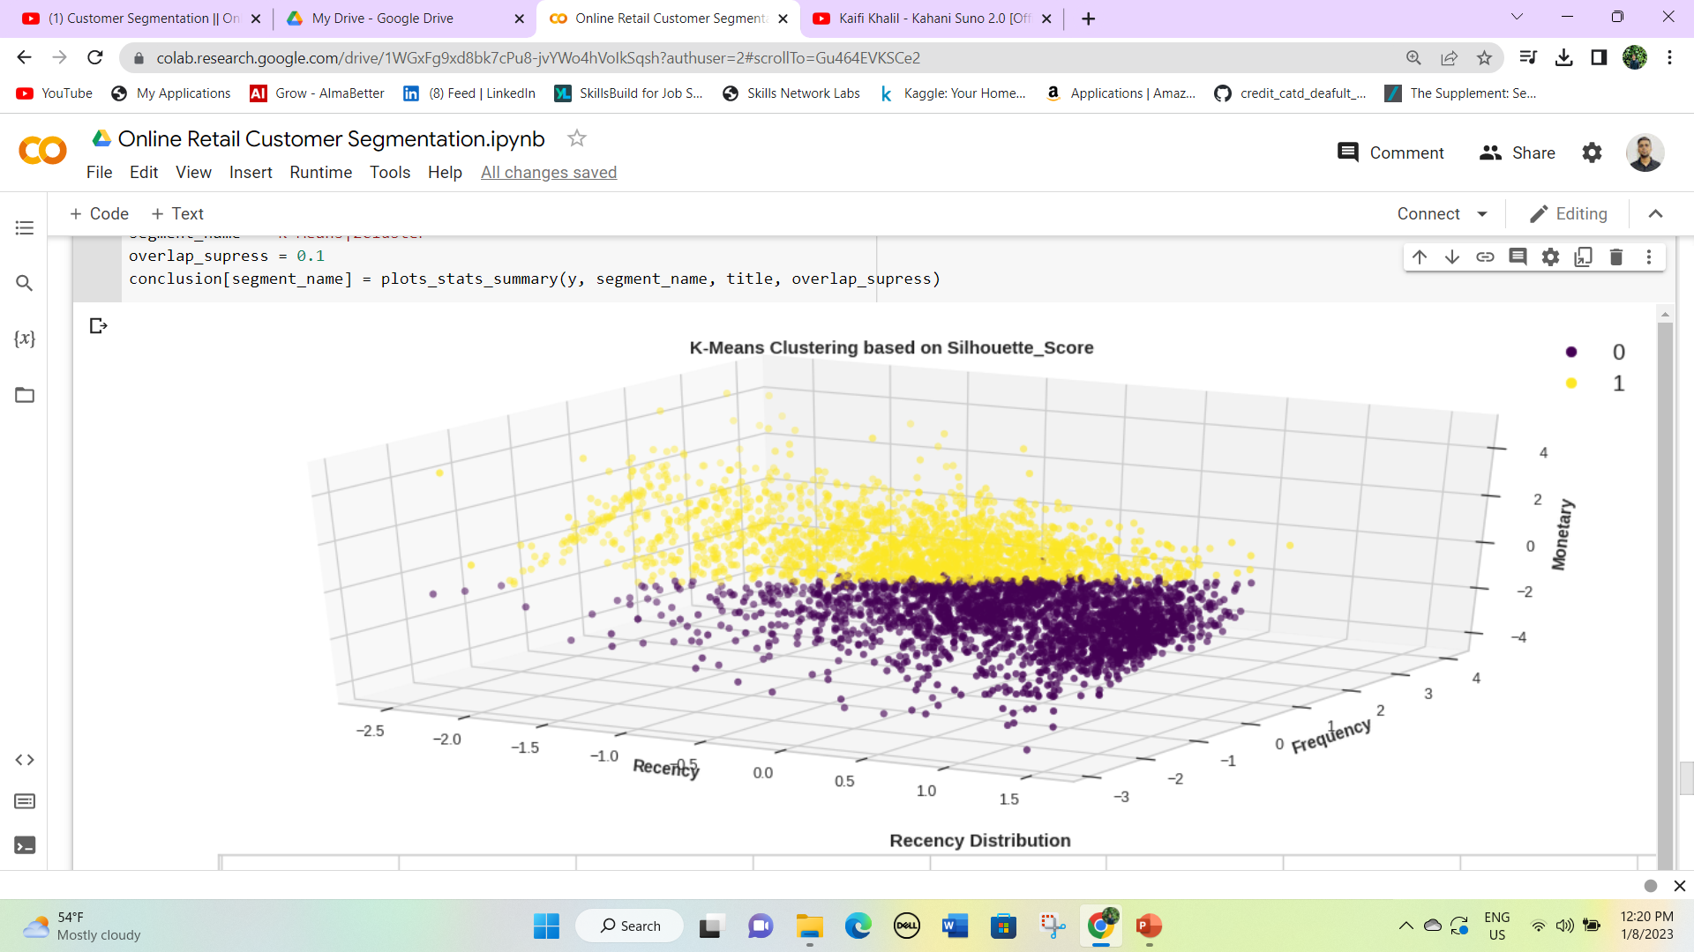
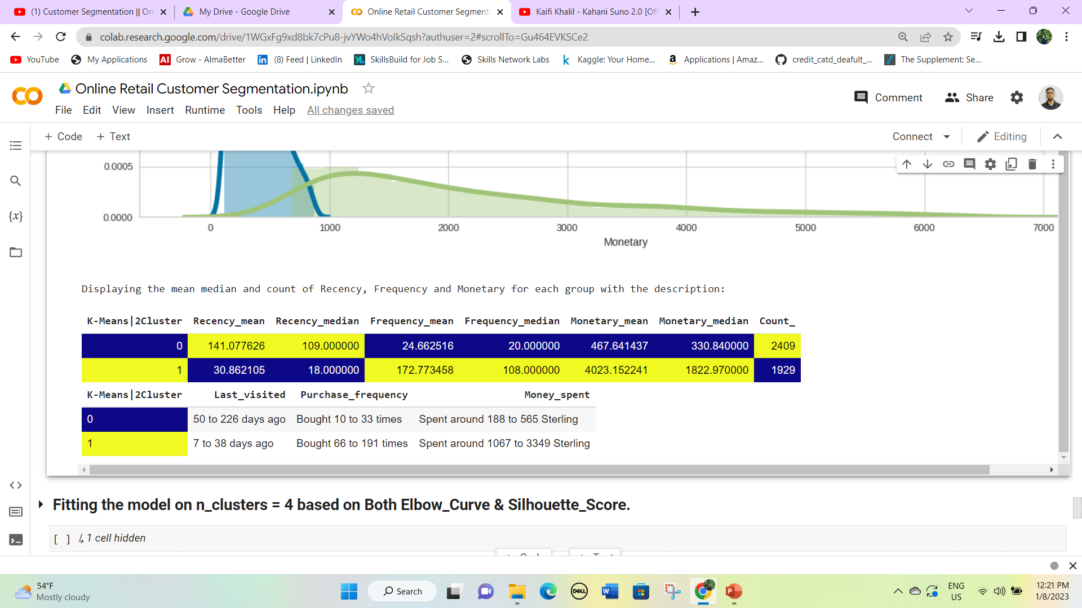
Fitting the model on n_clusters = 2 based on Silhouette Score to visualise the segments
Here we have two clusters 0 and 1.
0 cluster has a customer count of 2409 but Frequency and monetary are very low.
While 1 cluster has a count of 1929 but the frequency and monetary values are high.
So cluster 1 can be the target customer.

Slide 28
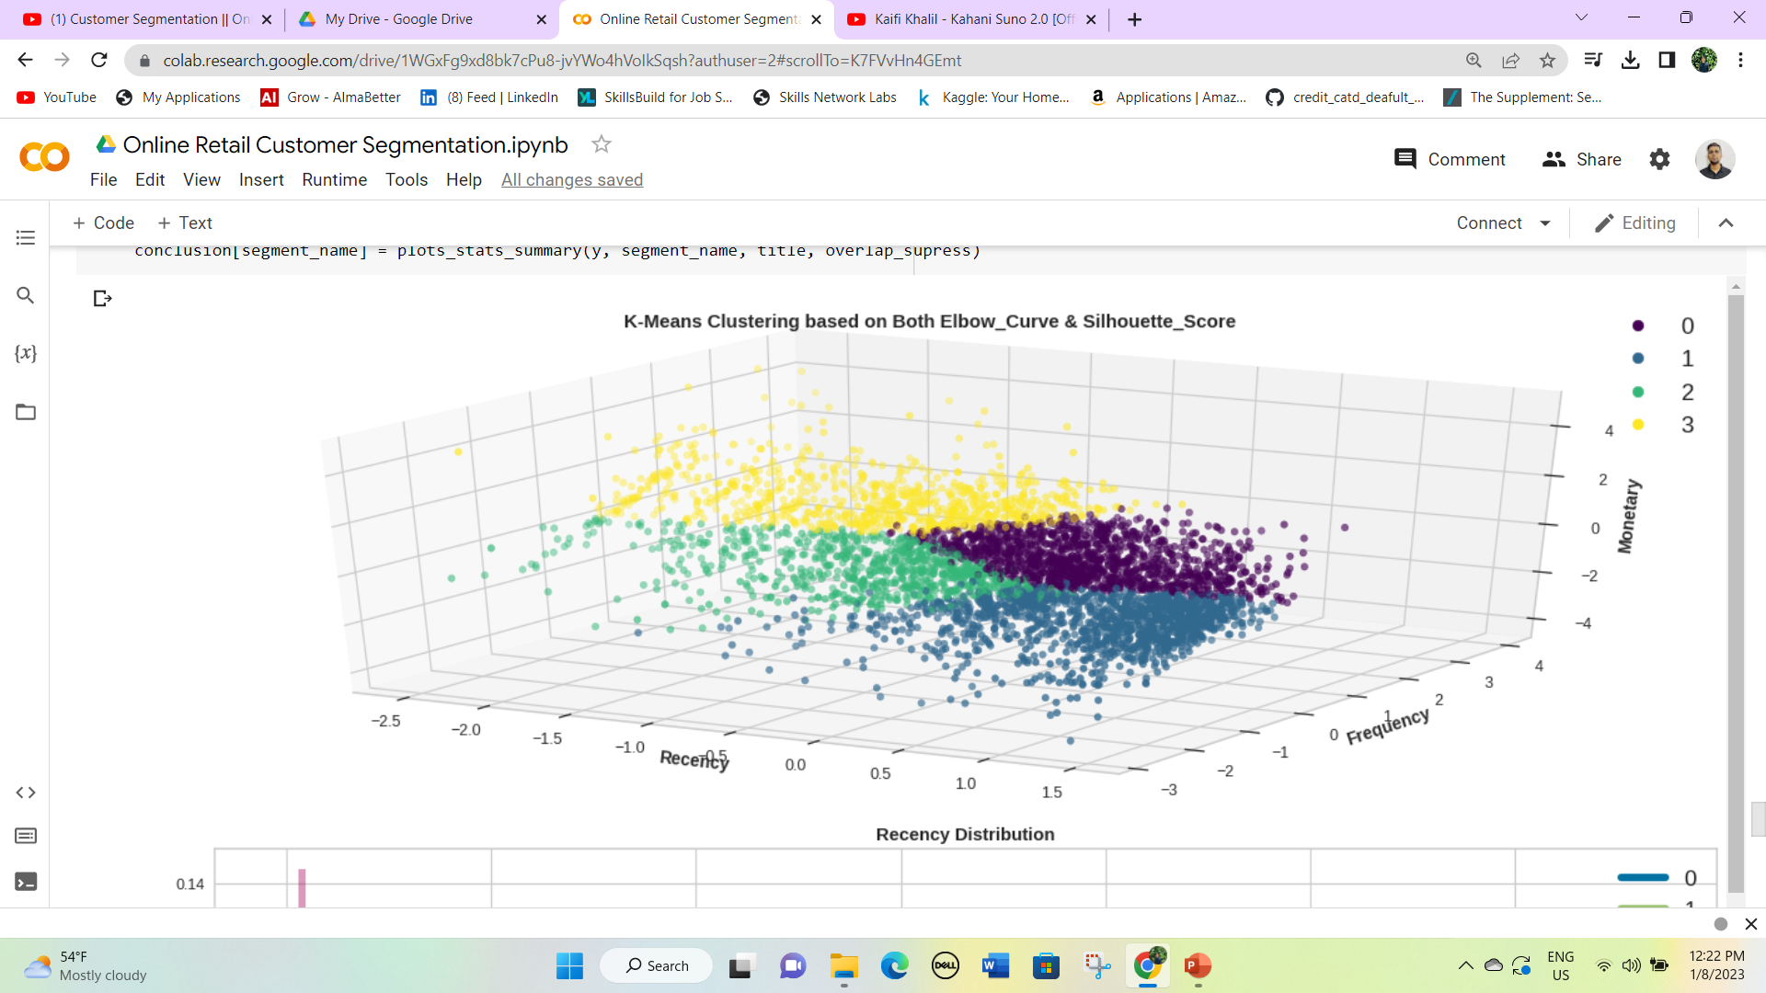
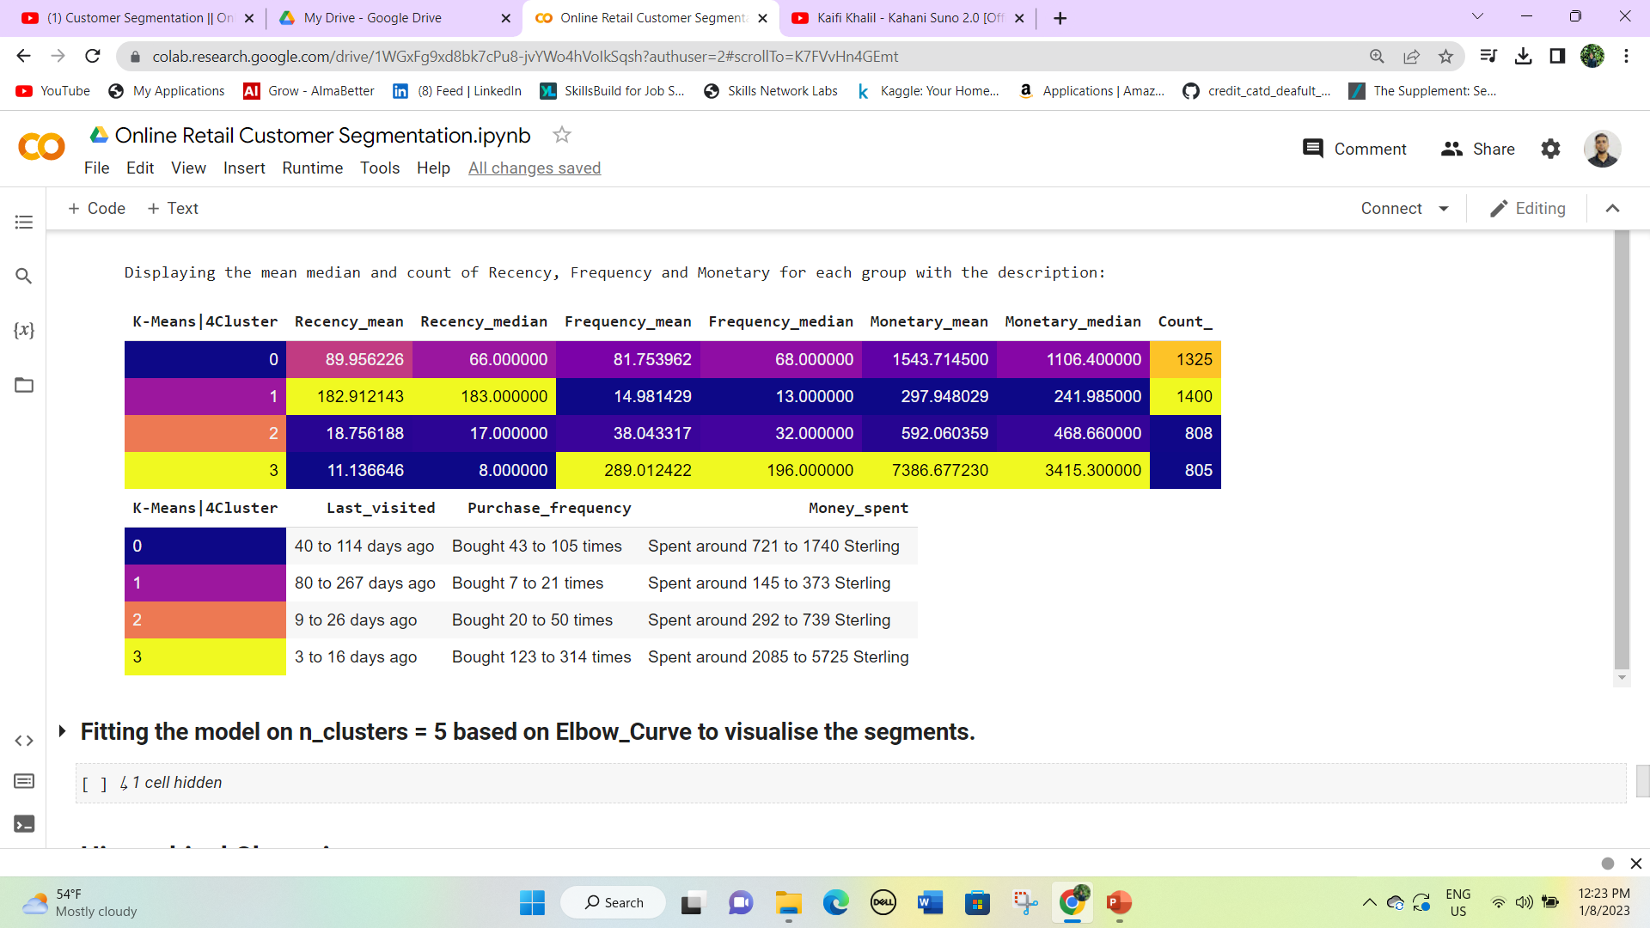
Fitting the model on n_clusters = 4 based on Both Elbow Curve & Silhouette Score.
Here we have four clusters 0, 1, 2, and 3. Based on the last visit and purchase frequency we will classify the names of the clusters.
Cluster 0 represents Silver group customers.
Cluster 1 represents Bronz customers.
Cluster 2 represents Gold customers.
Cluster 3 represents Platinum customers.

Slide 29
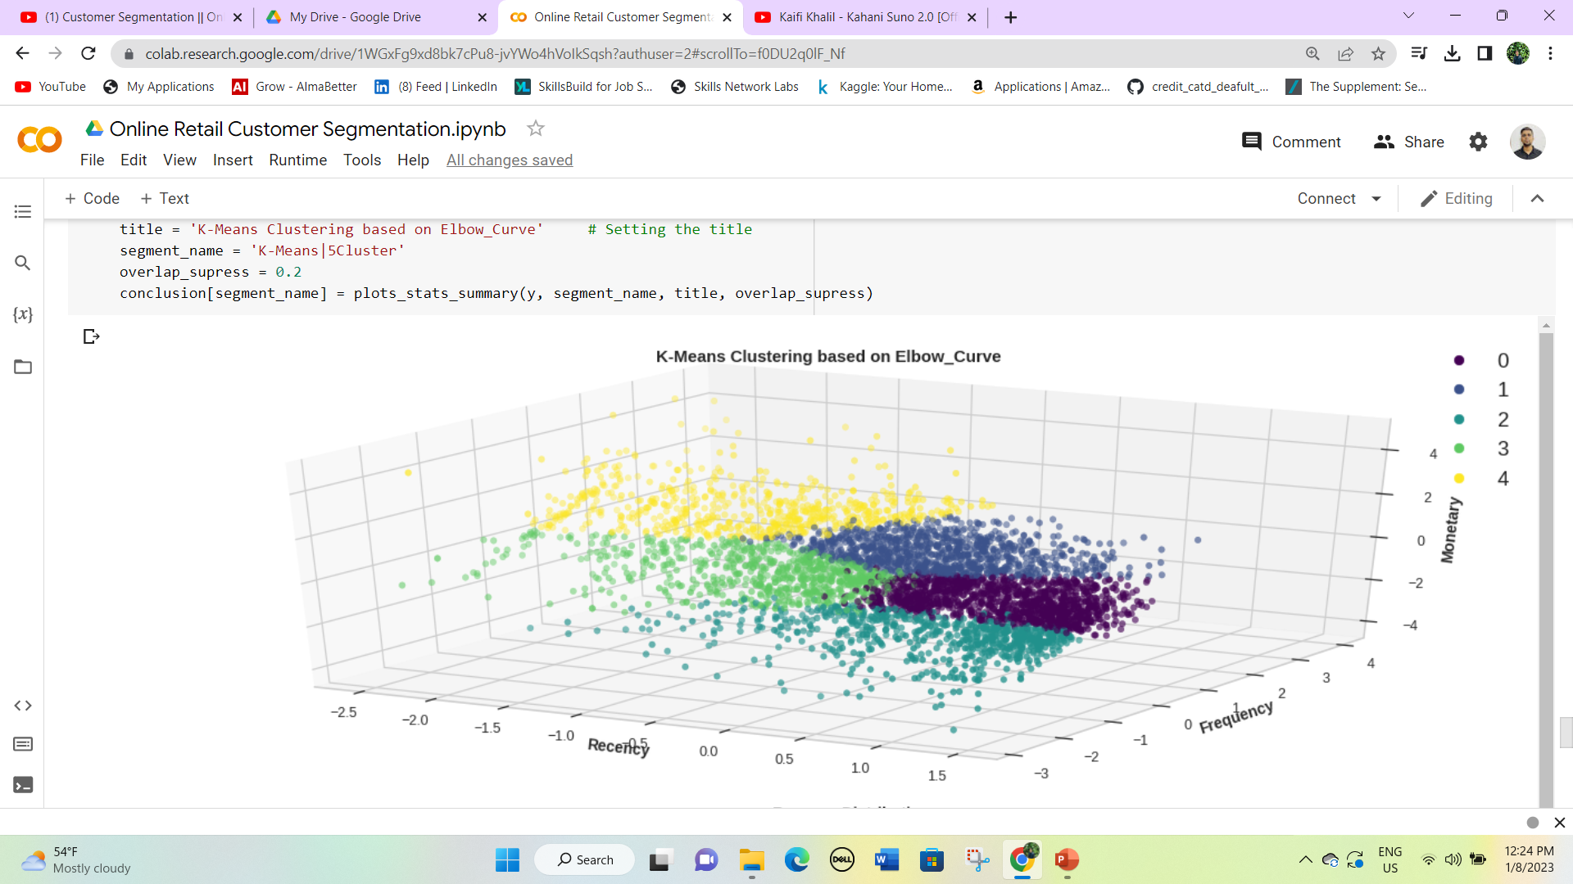
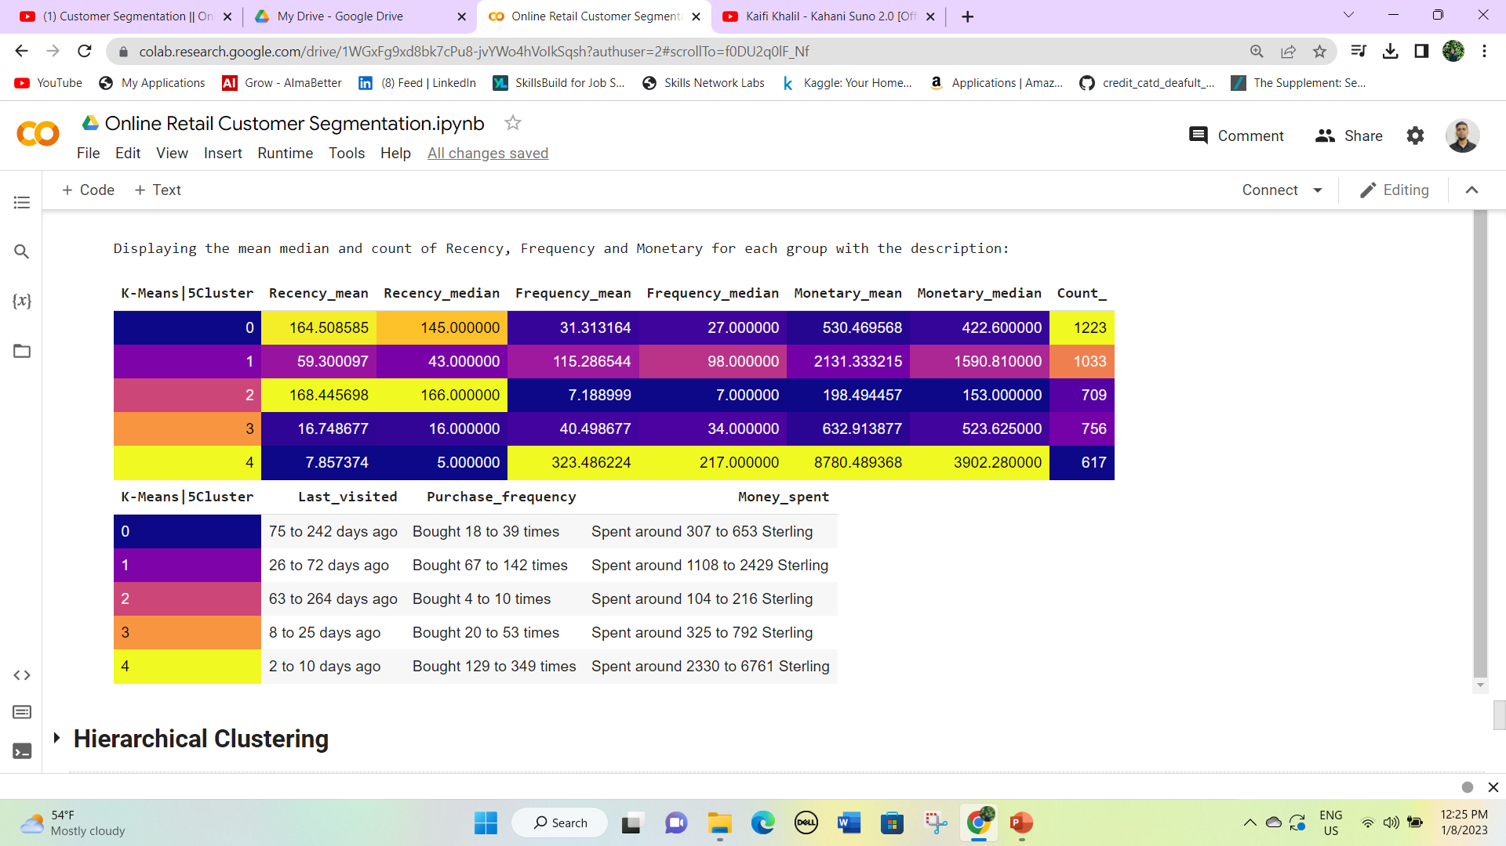
Fitting the model on n_clusters = 5 based on Elbow Curve to visualize the segments.
Here we have four clusters 0, 1, 2, 3, and 4. Based on the last visit and purchase frequency we will classify the names of the clusters.
Cluster 4 represents Platinum group customers.
Clusters 1 and 3 represent Gold customers.
Cluster 2 represents Bronz customers.
Cluster 0 represents Silver customers.

Slide 30
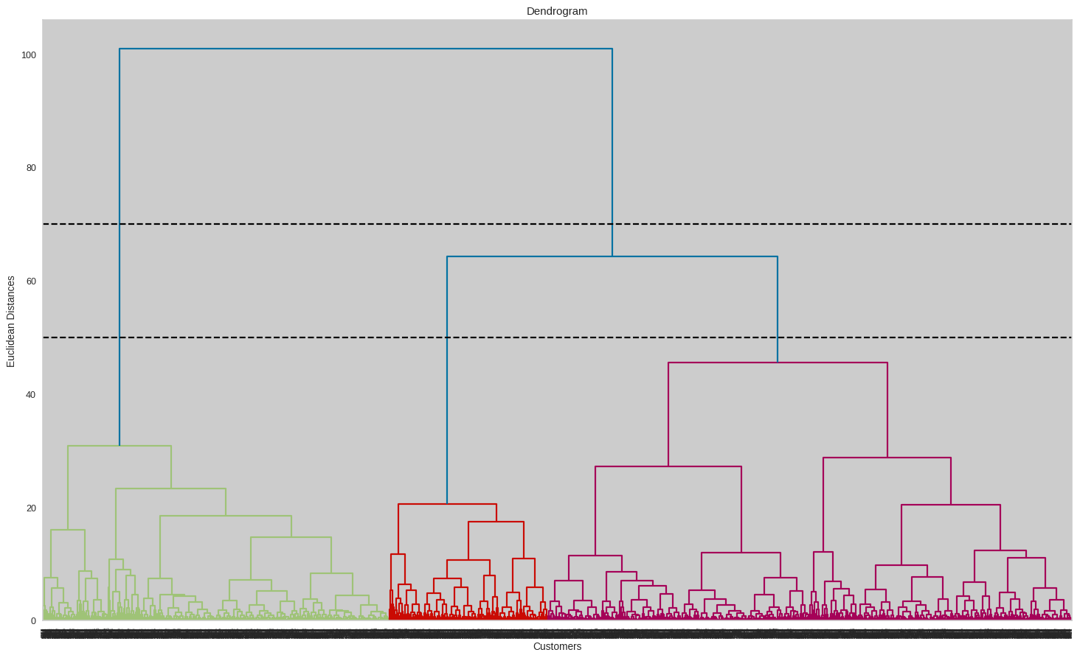
Hierarchical Clustering
We can set a threshold distance and draw a horizontal line (Generally, we try to set the threshold in such a way that it cuts the tallest vertical line).
We can set this threshold as 50 or 70 and draw a horizontal line as shown in the dendrogram above.
The number of clusters will be the number of vertical lines which are being intersected by the line drawn using the threshold.
The larger threshold (y=70) results in 2 clusters while the smaller (y=50) results in 3 clusters.

Slide 31
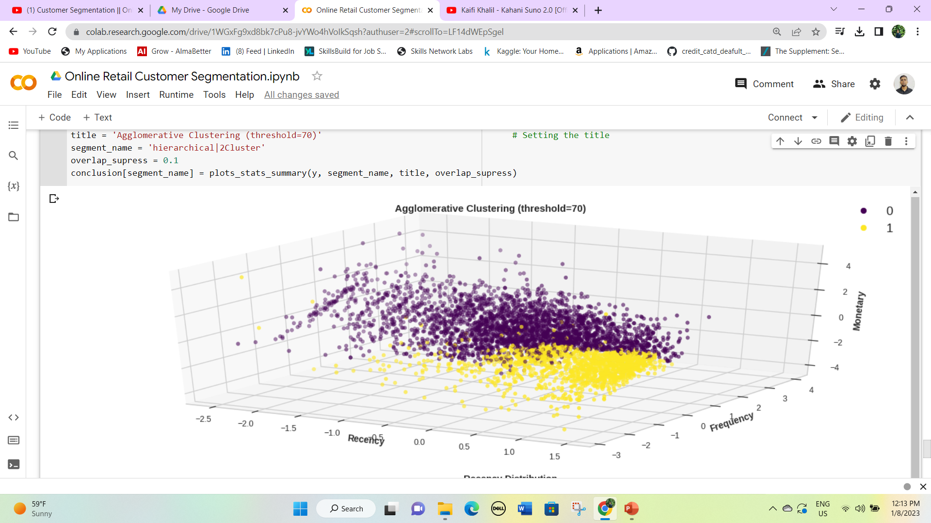
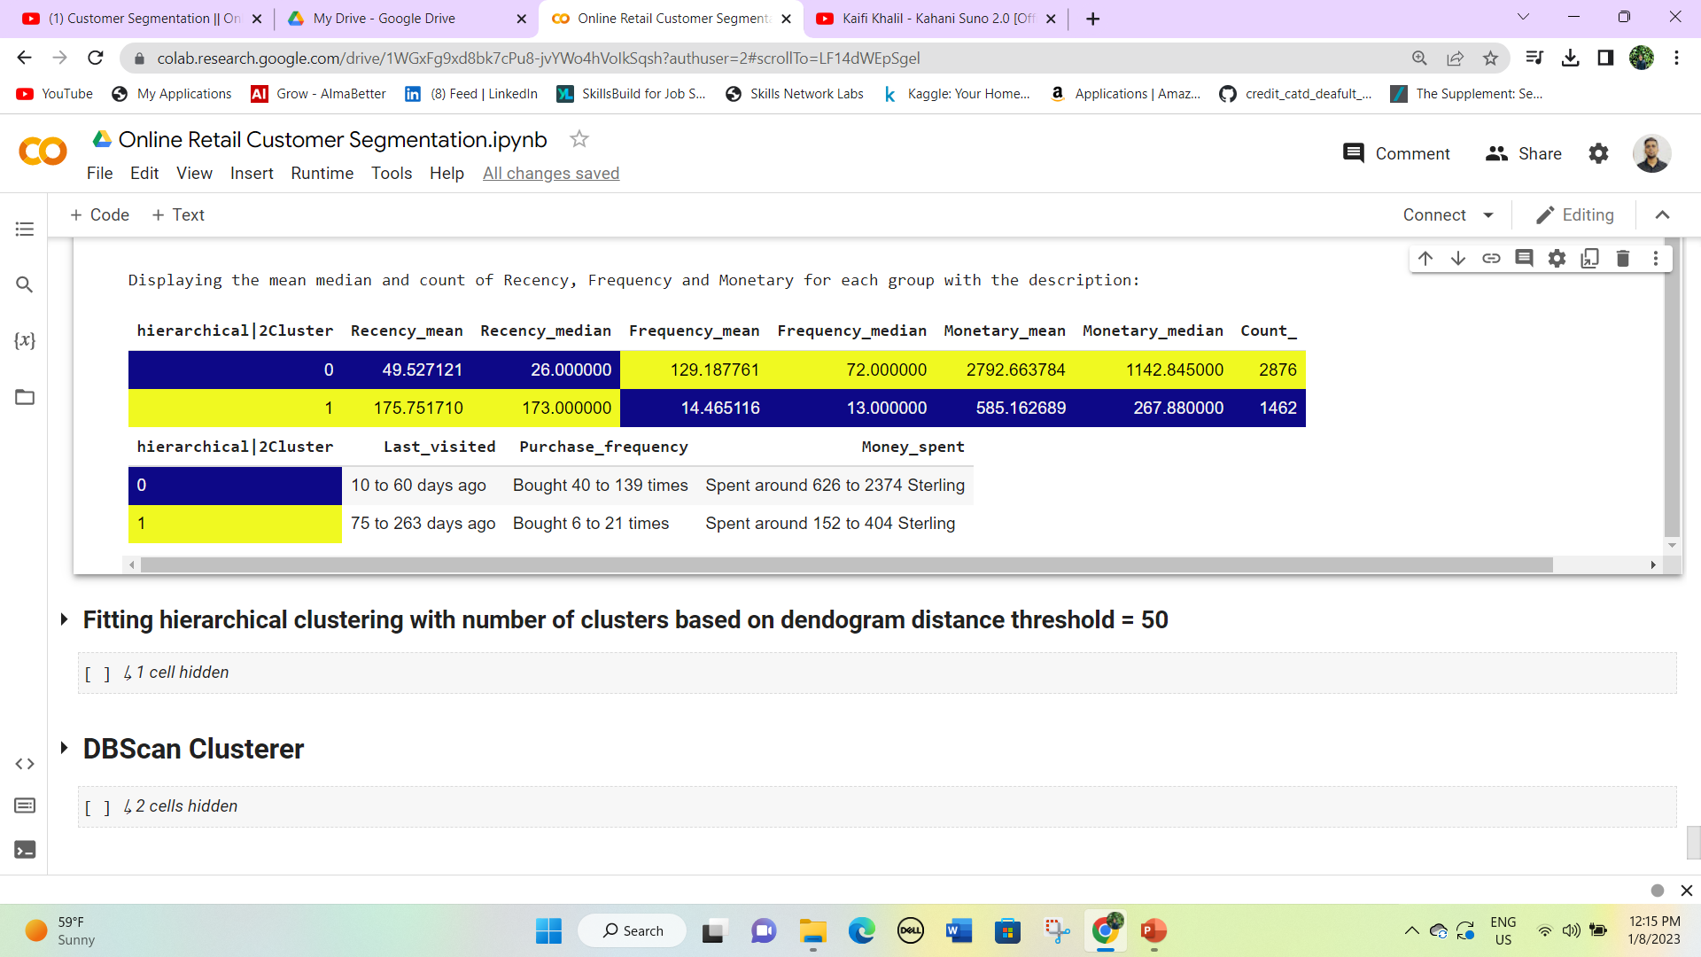
Fitting hierarchical clustering with the number of clusters based on dendrogram distance threshold = 70
Here we have two clusters 0 and 1.
0 cluster has a customer count of 2876 but Frequency and monetary are very high.
While 1 cluster has a count of 1462 but the frequency and monetary values are low.
So cluster 0 can be the target customer.

Slide 32
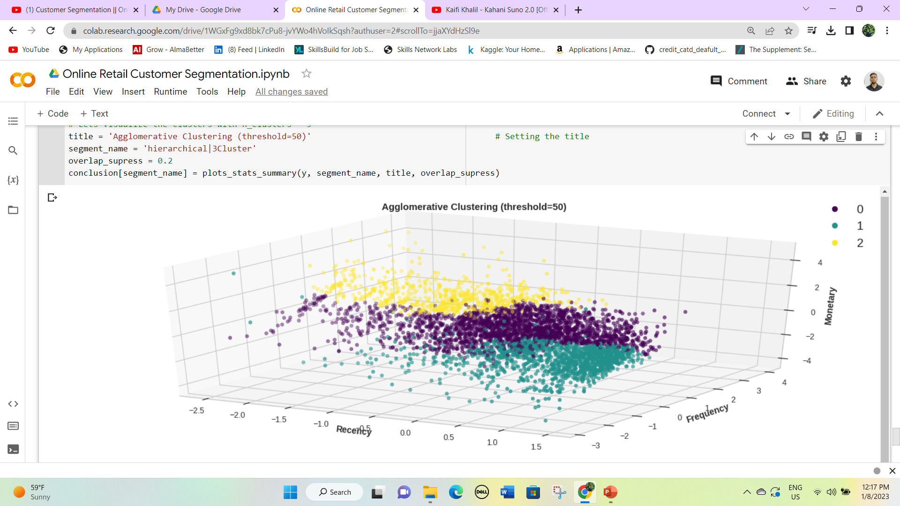
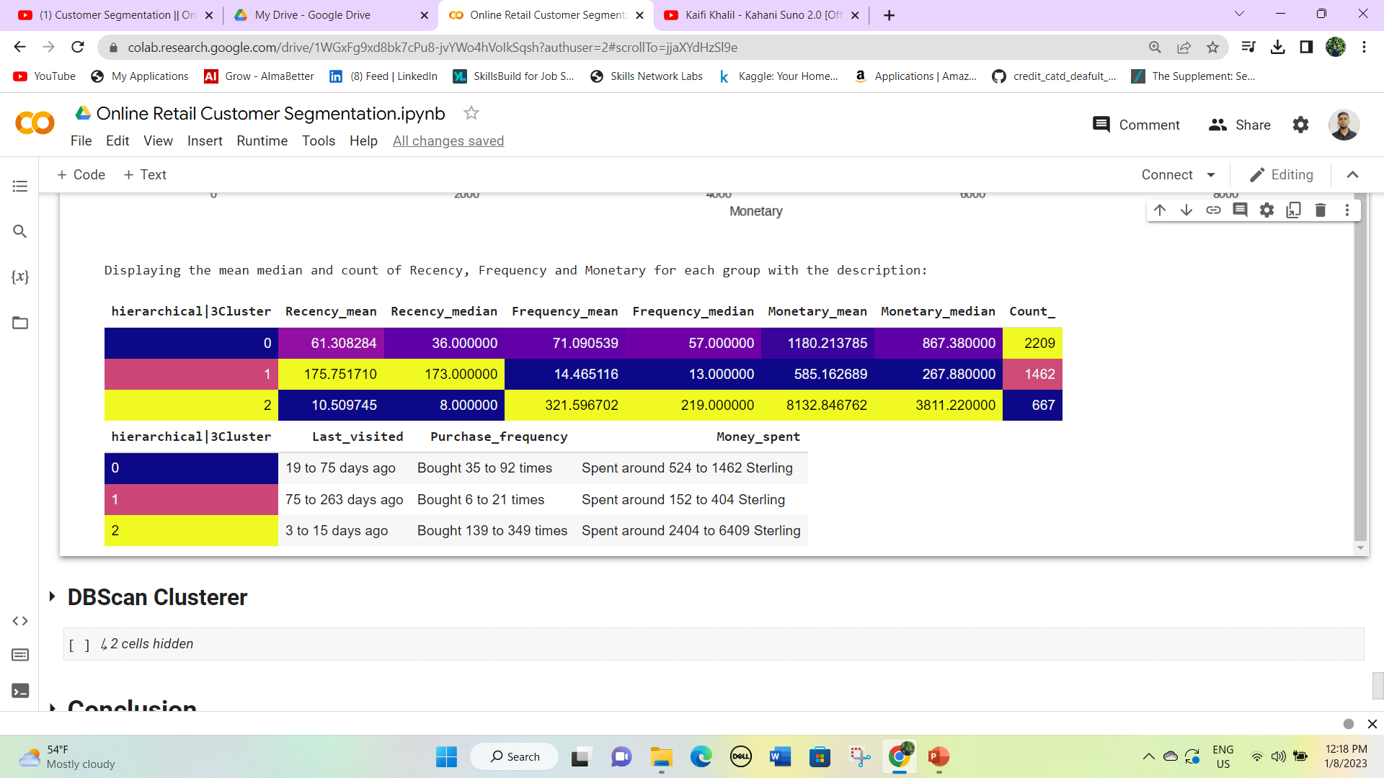
Fitting hierarchical clustering with the number of clusters based on dendrogram distance threshold = 50
Here we have four clusters 0, 1, 2. Based on the last visit and purchase frequency we will classify the names of the clusters.
Since monetary and frequency are moderate, so we can say that cluster 0 represents Gold or Silver Customer.
Cluster 1 represents Bronz customers because the recency value is highest for this cluster.
Cluster 2 represents Platinum customers because of low recency and high frequency and monetary.

Slide 33
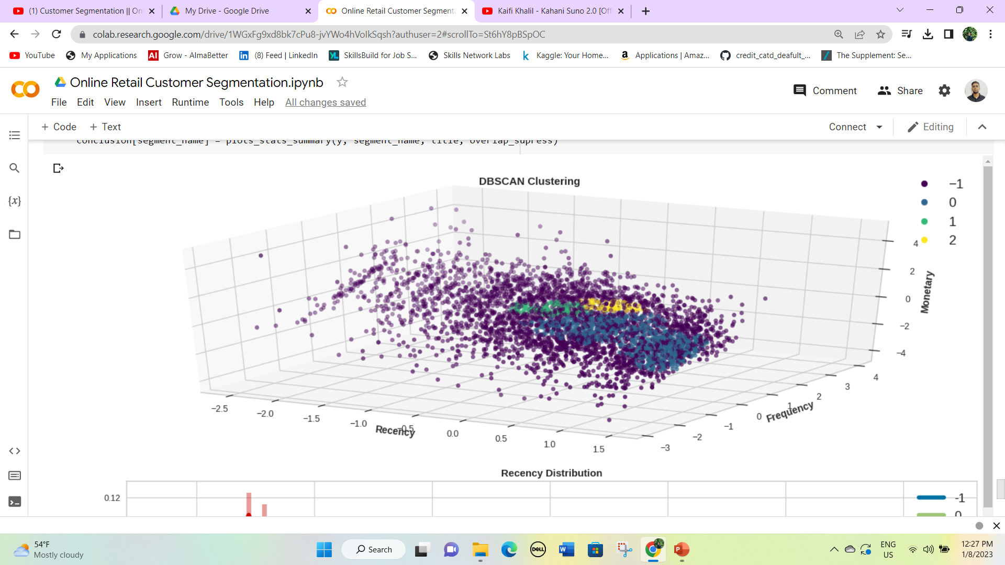
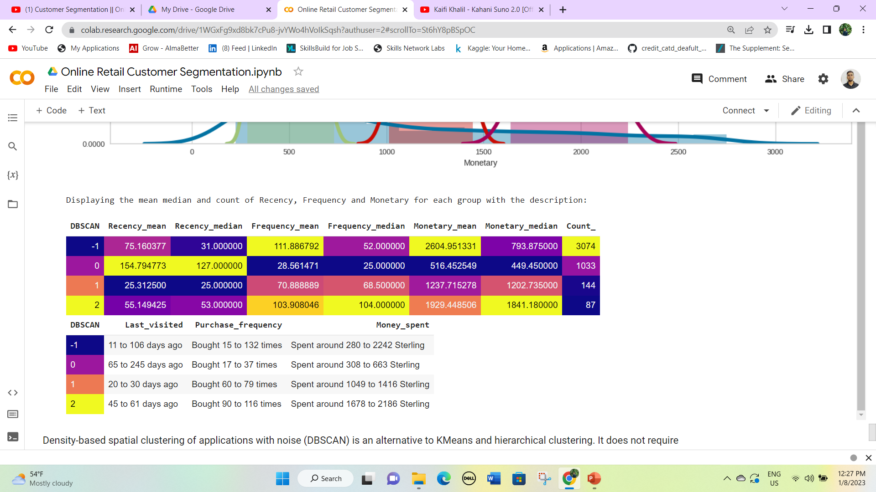
DB Scan Cluster
Density-based spatial clustering of applications with noise (DBSCAN) is an alternative to K-Means and hierarchical clustering.
It does not require us to specify the number of clusters, as the clusters are formed by a process of linking neighbor points together.
It avoids outliers and identifies nested clusters within the data. The data is muddled and does not have a major visible nested cluster, yet it has identified 4 clusters as shown above based on the hyperparameters defined.

Slide 34
Conclusion
We started with a simple binning and quantile-based simple segmentation model first then moved to more complex models because simple implementation helps have a first glance at the data and know where/how to exploit it better.
Then we moved to k-means clustering and visualized the results with different numbers of clusters. As we know there is no assurance that k-means will lead to the global best solution. We moved forward and tried Hierarchical Clustering and DBSCAN clustering as well.
We created several useful clusters of customers on the basis of different metrics and methods to categorize the customers on the basis of their behavioral attributes to define their evaluability, loyalty, profitability, etc for the business. Though significantly separated clusters are not visible in the plots, but the clusters obtained are fairly valid and useful as per the algorithms and the statistics extracted from the data.
Segments depend on how the business plans to use the results, and the level of granularity they want to see in the clusters. Keeping these points in view we clustered the major segments based on our understanding of different criteria as shown in the summary data frame.

